Slide 1
Clickbait Detector
CS7641-Machine Learning Project Proposal
Narges Moeini, Zachary Aristei, Stephan Tserovski, Jay Cha, Ehsan Asadollahi

Slide 2
Introduction

Slide 3
Introduction:
Zachary:
Content Monetization: Creators use clicks and views to generate revenue.
Clickbait Issue: Misleading titles drive clicks but frustrate users.

Slide 4
Problem Definition
Motivation, Problem Definition

Slide 5
Problem Definition:
Stephan:
Motivation: Clickbait is far too prevalent in online media
Leads to consumers being misled and frustrated
Automatically blocking clickbait would lead to a better user experience
Problem: Make an AI model that can automatically detect clickbait
Must be generalized to work across different types of media
Other models for clickbait detection tend to have smaller scopes such as only looking at news articles

Slide 6
Methods
Preprocessing Methods, ML Methods

Slide 7
Methods:
Narges:
Preprocessing Methods
Data Cleaning
Feature engineering
Data transformation
ML Methods
Unsupervised
K-means
Supervised
Logistic Regression
Random Forest

Slide 8
Potential Results and Discussion
Metrics, expected results, and goals

Slide 9
Potential Results and Discussion:
Jay:
Evaluation metrics
Accuracy: Fraction of correct predictions on the test set
Precision, recall, F1 score: Information based on true/false positive/negative categories
Confusion matrix: Visualize performance across the categories
Expected results
Successfully identify clickbait titles across various media
Project goals
Deploy our model in the real world
Allow users to make informed decisions about the content they engage with
Discourage the spread of deceptive and harmful practices on the internet

Slide 10
Gantt Chart and Contribution Table

Slide 11
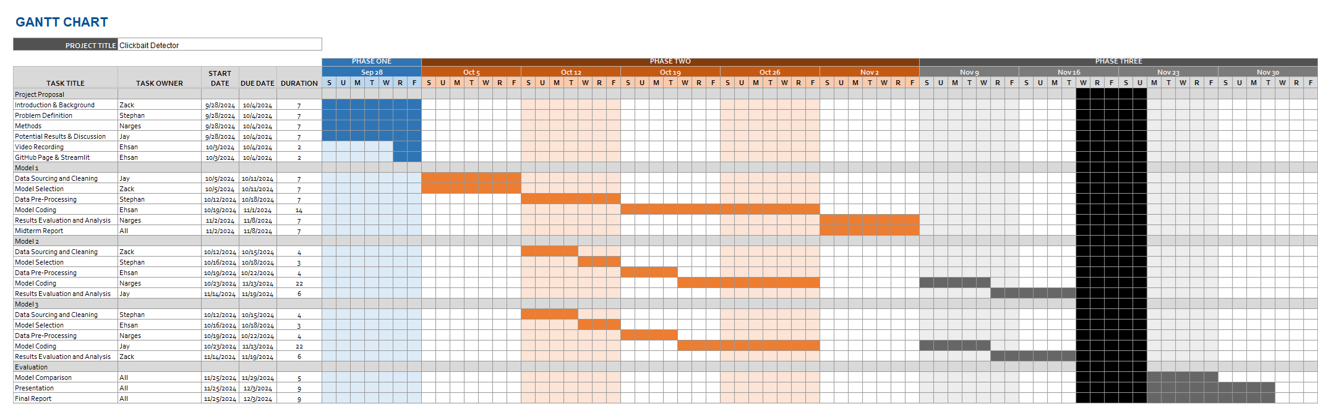
Gantt Chart and Contribution Table:

Slide 12

Thanks for your attention!

